Slide 1
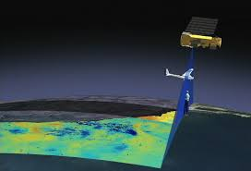
LESSON 2
Basics of Remote Sensing
( contd)

Slide 2
SUMMARY OF LECTURE 1
Remote Sensing Definition
Component of Remote sensing
Planck’s Law
Peak wavelength from sun and earth
Available radiation for RS from sun
OR
Wavelength or EM waves absorbed by atmosphere
https://www.nrcan.gc.ca/maps-tools-publications/satellite-imagery-air-photos/tutorial-fundamentals-remote-sensing/9309

Slide 3
REMOTE SENING DATA COLLECTION METHODS
OPTICAL/IR REMOTE SENSING
PANCHROMATIC
COLOR
MULTISPECTRAL
HYPERSPECTRAL

Slide 4
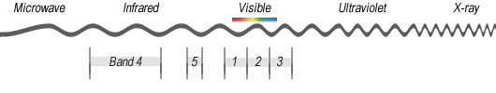
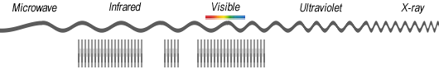
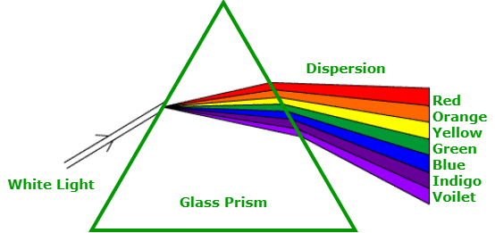
Panchromatic
Multispectral
Hyperspectral

Slide 5

Electromagnetic spectrum
Visible (400 nm - 1000 nm, VIS)
Infrared (~ 10,000 nm, IR)
Microwave (MW)
active (0.3-30 GHz)
Links:
http://www.biogeorecon.com/remote.htm
http://www.eeb.ucla.edu/test/faculty/nezlin/SatellitesAndSensors.htm

Slide 6
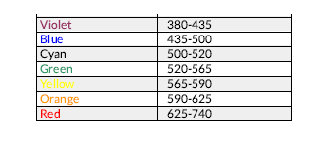
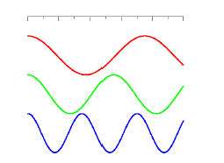
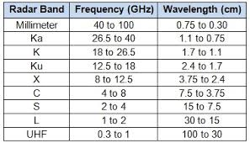
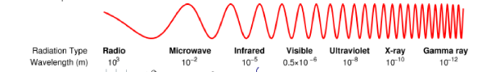
Comparison:
Micron= mm/1000
Wavelength ( Microwave) >>> Wavelength ( optical region)
In meters

Slide 7
Type of Remote Sensing
#Based on wavelength region
# Based on radiation source

Slide 8
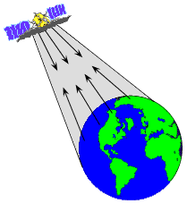
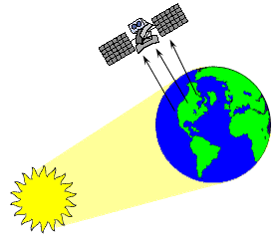
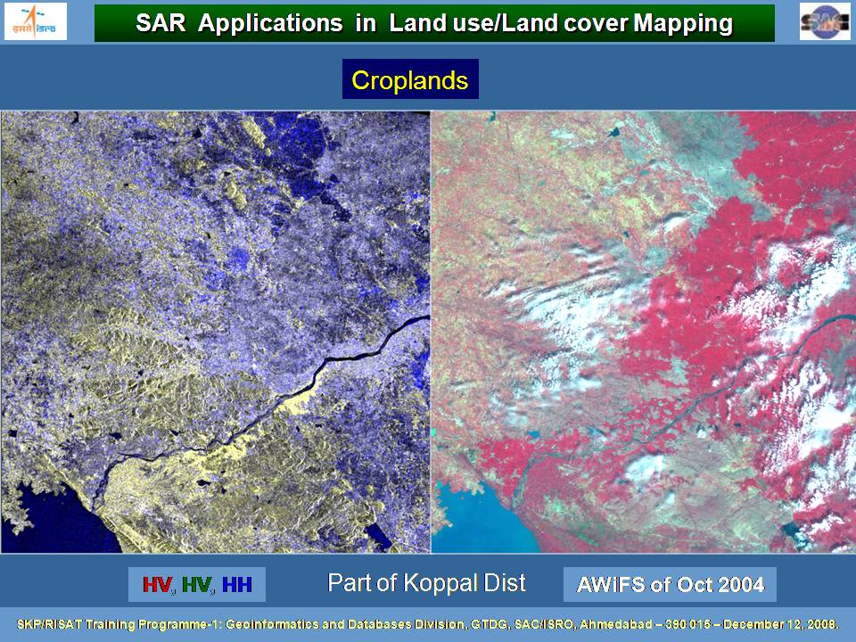
Active remote sensing
Passive remote sensing

Slide 9
A Systems View of Remote Sensing
Remote Sensing Instruments
Passive
Active
Reflected light
Thermal emission
Passive Microwave
Visible/IR
Active Microwave
Panchromatic
Visible/near IR/SWIR imaging
Laser Profiling and Lidar
Altimetry, Scatterometry
Synthetic Aperture Radar
Thermal imaging
Passive microwave radiometry
Microwave sounding
Notes:
Light amplifcation by stimulated emission of radiation
Light detection and ranging

Slide 10
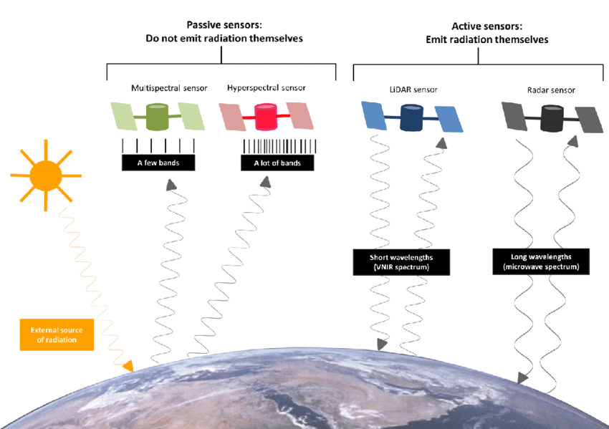
What are Type of Remote sensing: PASSIVE & ACTIVE
Advantage: Ability of seeing object beyond human eyes limit

Slide 11
Advantage of Remote Sensing
i) Provide data of large region- Synoptic view
ii) Provide data of remote and inaccessible terrain
iii) Ability to obtain data of any region for repeated period of time.
iv) Ability to acquire data at any time of day
v) Ability to acquire data in cludy condition
vi) relatively less cost as compared to human intensive mapping.
v) Easy and rapid method of mapping
No human bias.
Can acquire data beyond human vision.
Quick information
Multispectral view

Slide 12
INTERACTION OF LIGHT WITH SURFACE MATERIAL
HOW WE SEE COLORS- HUMAN AND INSTRUMENT SIMILIARITY
LIGHT ABSORPTION, SCATTERING AND TRANSMISSION
HOW MUCH ADVANTAGE:SPECTRAL VIEW
SIGNATURE: A KEY OF REMOTE SENSING DATA INTERPRETATION
WHAT ARE PANCHROMATIC, MULTISPECTRAL AND HYPERSPECTRAL OBSERVATIONS

Slide 13
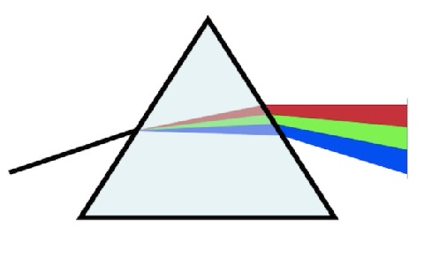
blue light, with a higher refractive index, will be bent more strongly than red light, resulting in the well-known rainbow pattern.
Color | Wavelength
Violet | 4000 Å to 4240 Å
Blue | 4240 Å – 4912 Å
Green | 4912 Å – 5750 Å
Yellow | 5750 Å – 5850 Å
Orange | 5850 Å – 6470 Å
Red | 6470 Å – 7000 Å

Slide 14
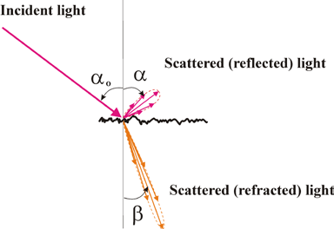
Reflection is the process by which electromagnetic radiation is returned either at the boundary between two media (surface reflection) or at the interior of a medium (volume reflection)
transmission is the passage of electromagnetic radiation through a medium.
Both processes can be accompanied by diffusion (also called scattering), which is the process of deflecting a unidirectional beam into many directions. In this case, we speak about diffuse reflection and diffuse transmission

Slide 15
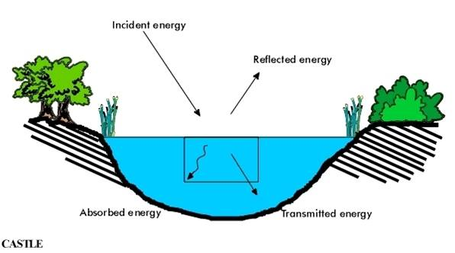
INTERACTION OF RADIATION SURFACE MAtERIAL
There are three forms of interaction that can take place when energy strikes, or is incident (I) upon the surface. These are: absorption (A); transmission (T); and reflection (R)
Φλ = ρλ + αλ +τλ [where Φλ is radiative flux; ρλ is the amount of reflected energy; αλ is the amount of absorbed energy; and τλ is the amount of transmitted energy]
https://www2.geog.soton.ac.uk/users/trevesr/obs/rseo/energy_interactions_with_the_earths_surface.html

Slide 16
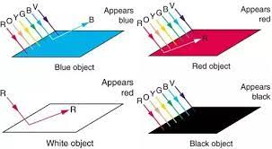
Where Does Color Come From?
The color of an object is not actually within the object itself.
Rather, the color is in the light that shines upon it and is ultimately
reflected
visible light spectrum consists of a range of frequencies, each of
which corresponds to a specific color

Slide 17
Darker colored objects heat up faster in the sun than light colored ones, which is why running across asphalt in bare feet can feel much hotter than walking across light-colored concrete

Slide 18
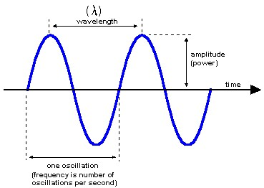
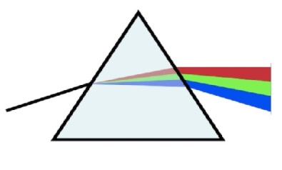
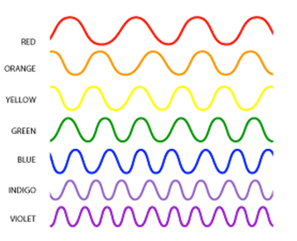
Color | Frequency | Wavelength
Violet | 668 THz to 789 THz | 400 to 440
Indigo | 600 THz to 700 THz | 440 to 460
Blue | 606 THz to 668 THz | 460 to 500
Green | 526 THz to 606 THz | 500 to 570
Yellow | 508 THz to 526 THz | 570 t0 590
Orange | 484THz to 508 THz | 590 to 620
Red | 400 THz to 484 THz | 620 to 720

Slide 20
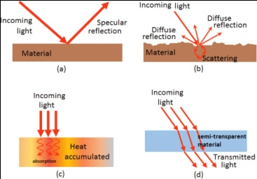
Radiation Interactions with Matter
Emission – release of electromagnetic waves ( Planck’s Law of radiation)
Absorption – receiving of electromagnetic waves
Scattering – deflection of electromagnetic waves in all directions ( Surface roughness relative to wavelength)
Reflection – deflection of electromagnetic waves into the backwards direction ( Smooth surface)

Slide 21

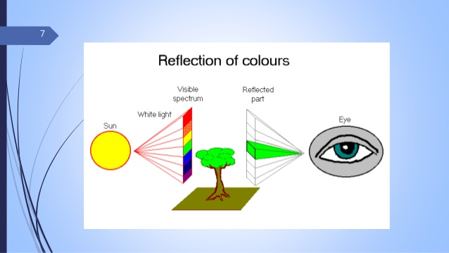

Slide 22
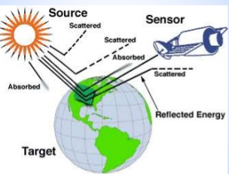
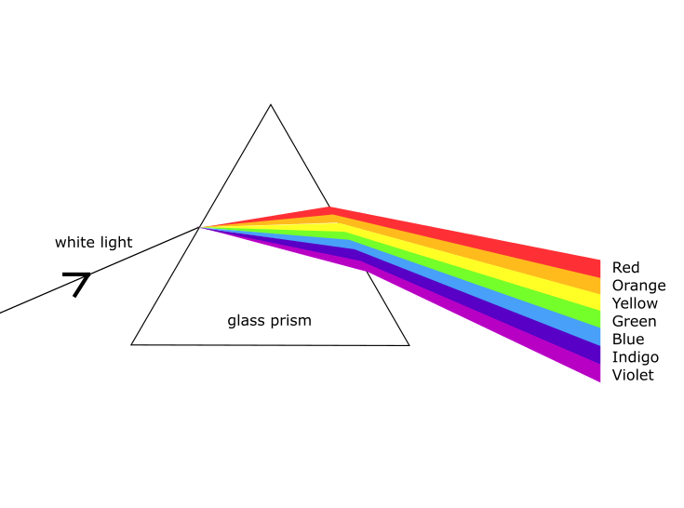

Slide 23
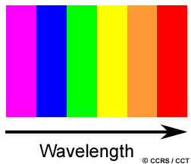
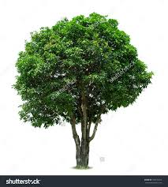
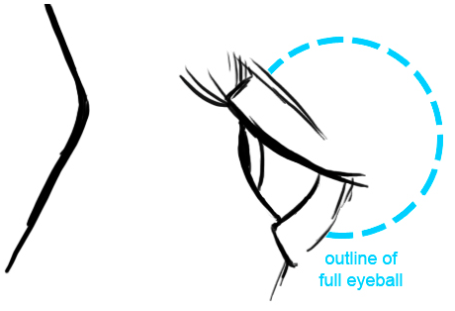
Amplitude
G

Slide 24

Amplitude
B
G
R
Leaf Fall

Slide 25

Tree with leave
Amplitude
Tree without leave
B
G
R
LOCATION

Slide 26

Tree with leave
Amplitude
Tree without leave
B
G
R
LOCATION1
LOCATION 2

Slide 27
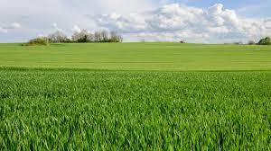
Green
Amplitude
G
LOCATION1
LOCATION 2

Slide 28


Reflectance Curve
Introduction to GIS
White Light
Blue
Green
Red
High
The wavelengths in which it is reflected determine the color of the object
Reflectance
Low
0.4μm
0.5μm
0.6μm
0.7μm
Blue
Green
Red
Source: Jarlath O’Neil-Dunne

Slide 29
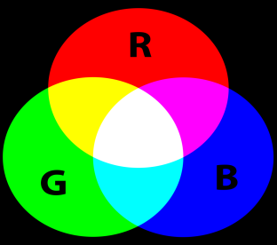
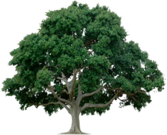
Reflectance Curve
Object recognition : SIGNATURE
White Light
Blue
Green
Red
High
The wavelengths in which it is reflected determine the color of the object
Reflectance
G
R
Low
0.4μm
0.5μm
0.6μm
0.7μm
Blue
Green
Red
Source: Jarlath O’Neil-Dunne

Slide 30
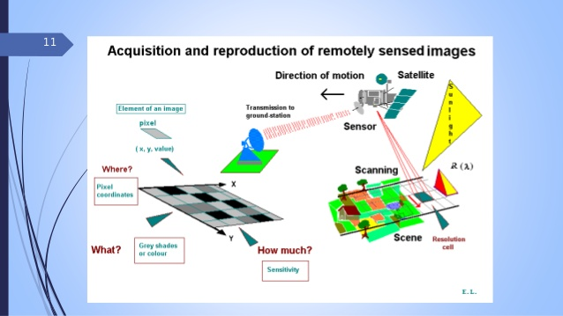

Slide 31
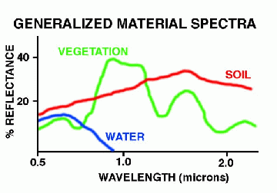
Spectral “Signatures”

Slide 32
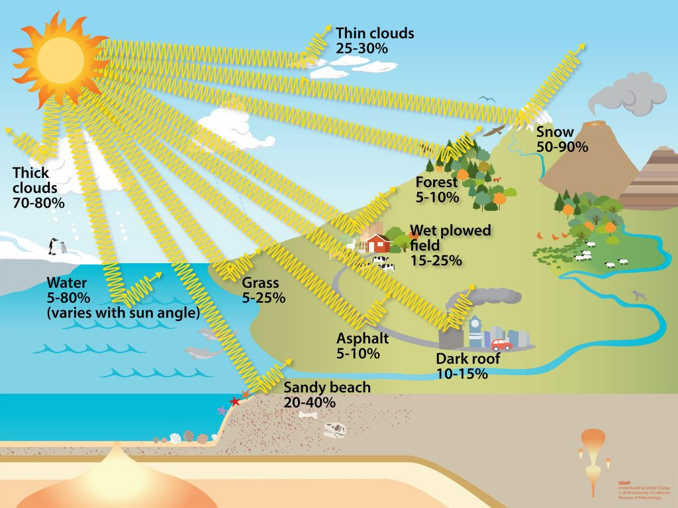
https://ugc.berkeley.edu/background-content/reflection-absorption-sunlight/

Slide 33
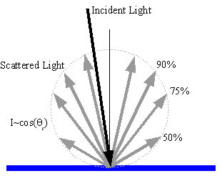
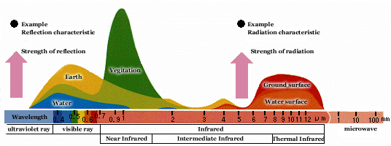
Distribution

Slide 34
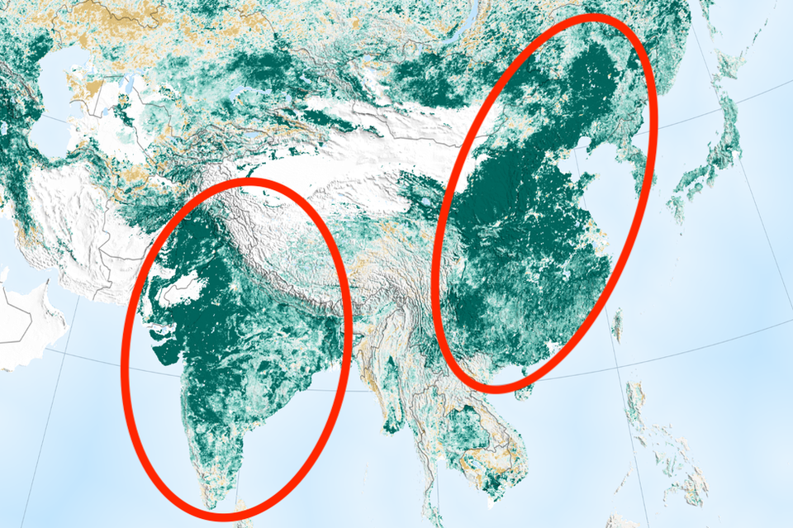
Greening of China and India
NASA
NASA has some good news, the world is a greener place today than it was 20 years ago.
https://www.forbes.com/sites/trevornace/2019/02/28/nasa-says-earth-is-greener-today-than-20-years-ago-thanks-to-china-india/?sh=4dfd8c6f6e13

Slide 35
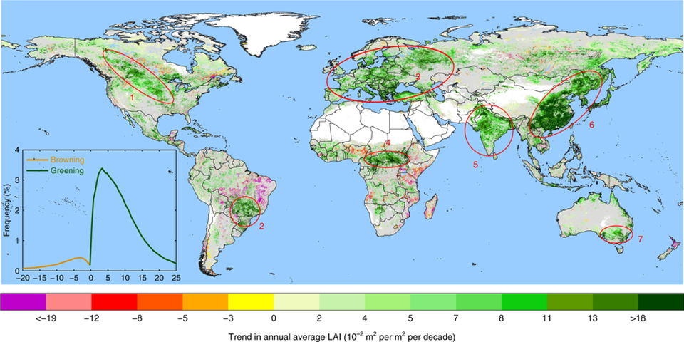

Slide 36
REMOTE SENING DATA COLLECTION METHODS
OPTICAL/IR REMOTE SENSING
PANCHROMATIC
MULTISPECTRAL
HYPERSPECTRAL

Slide 37
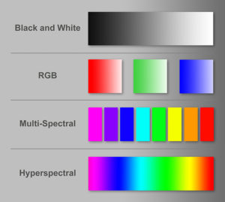
Panchromatic
Multispectral
Hyperspectral

Slide 38
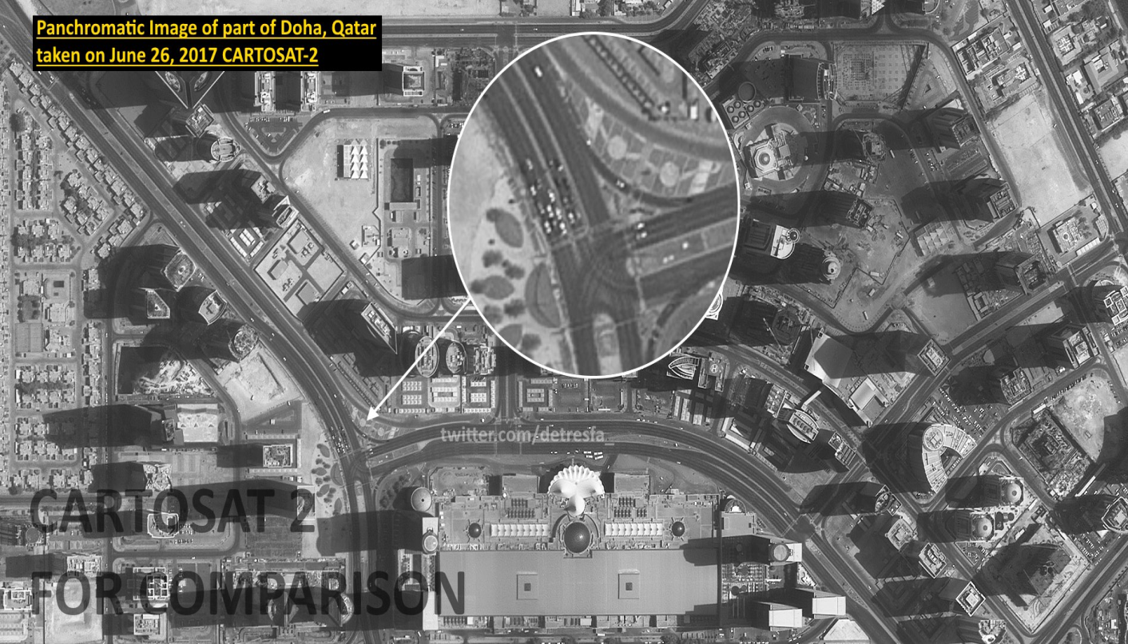
A panchromatic band (black and white band) is one band that usually contains a couple of hundred nanometers bandwidth. The bandwidth enables it to hold a high signal-noise, making the panchromatic data available at a high spatial resolution. This images can be gathered with a higher resolution since the spectral range give the smaller detectors allowance to be utilized while sustaining the high signal-noise ratio.
Advantage:
High SNR
High resolution
Cartosat-3 has a ground
resolution of 0.25 m with
16 km swath
Doha
Cartosat-3
https://eos.com/panchromatic/

Slide 39
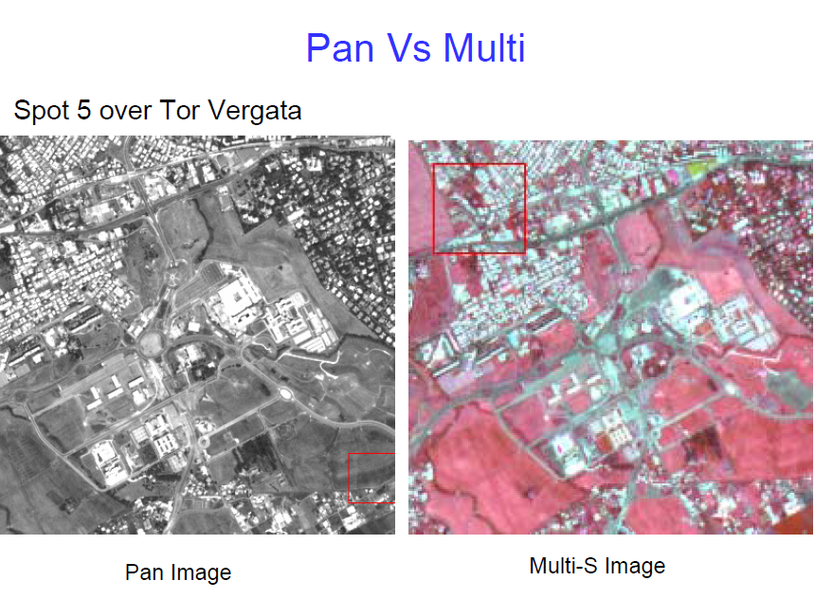

Slide 40
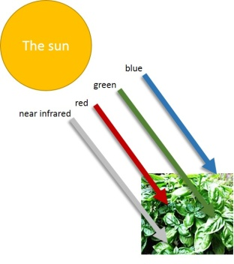
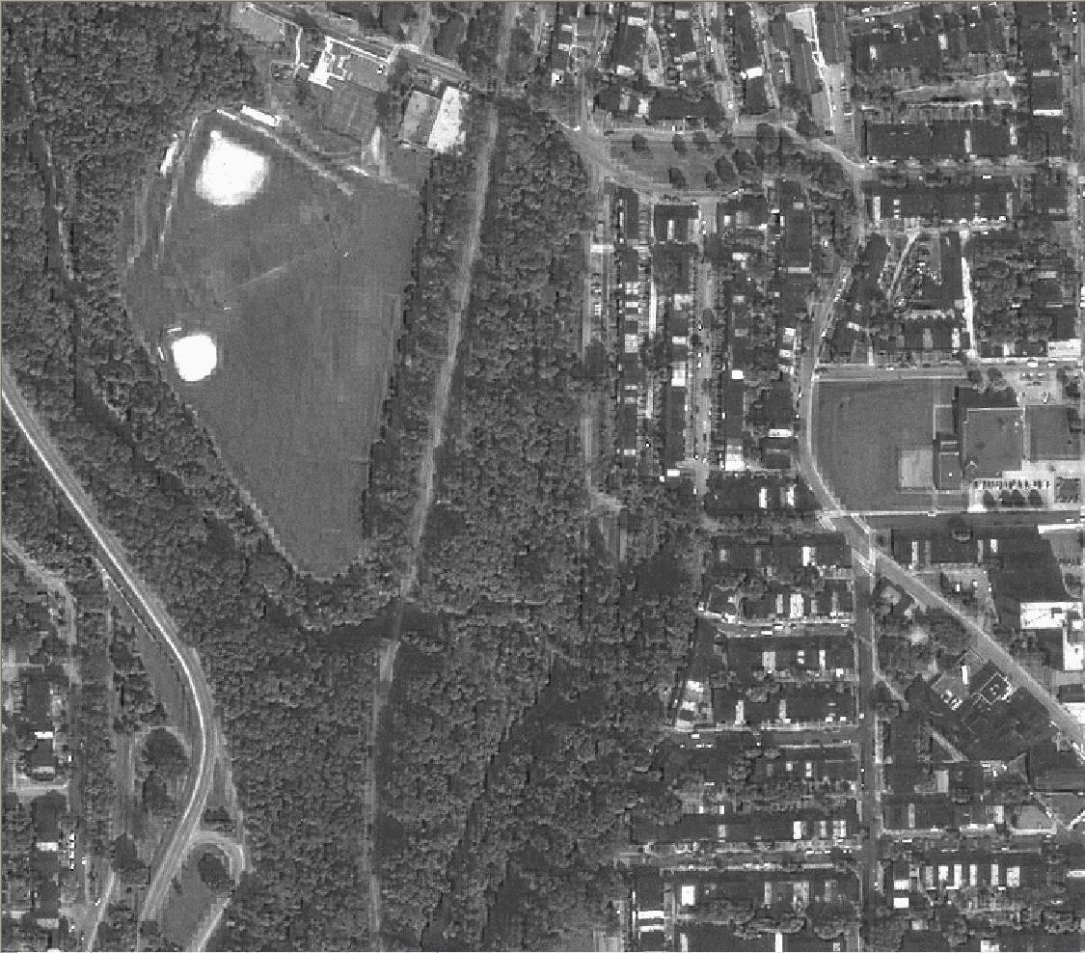
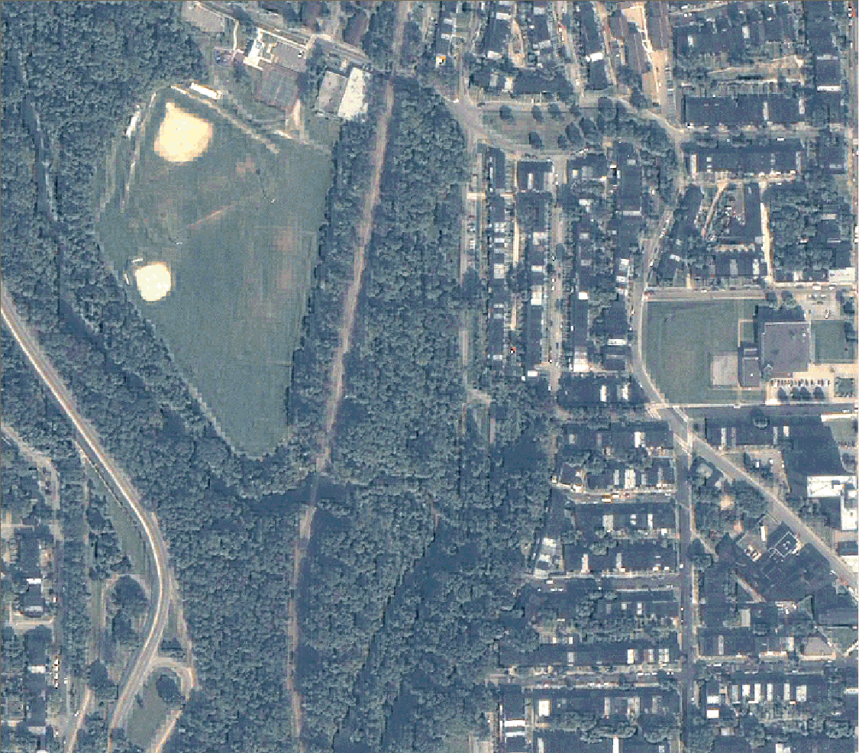
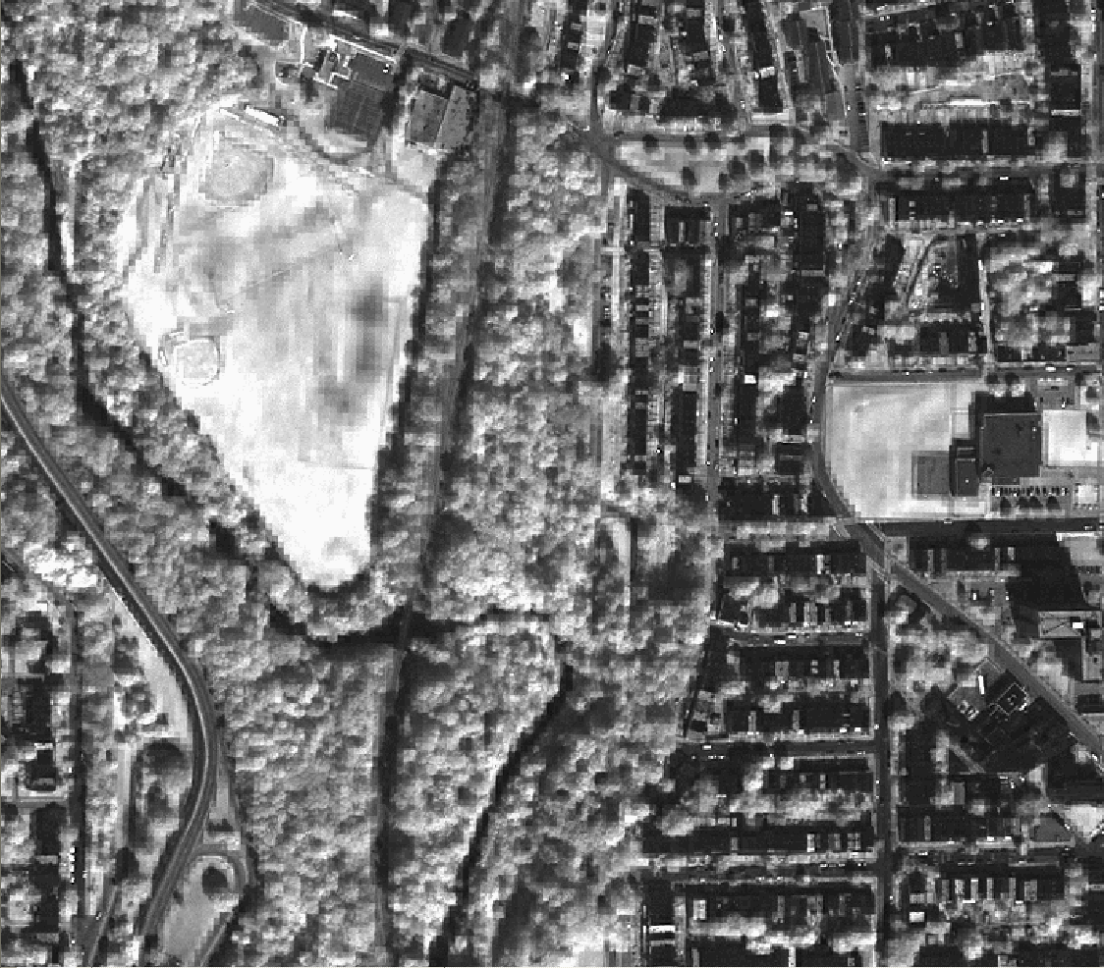
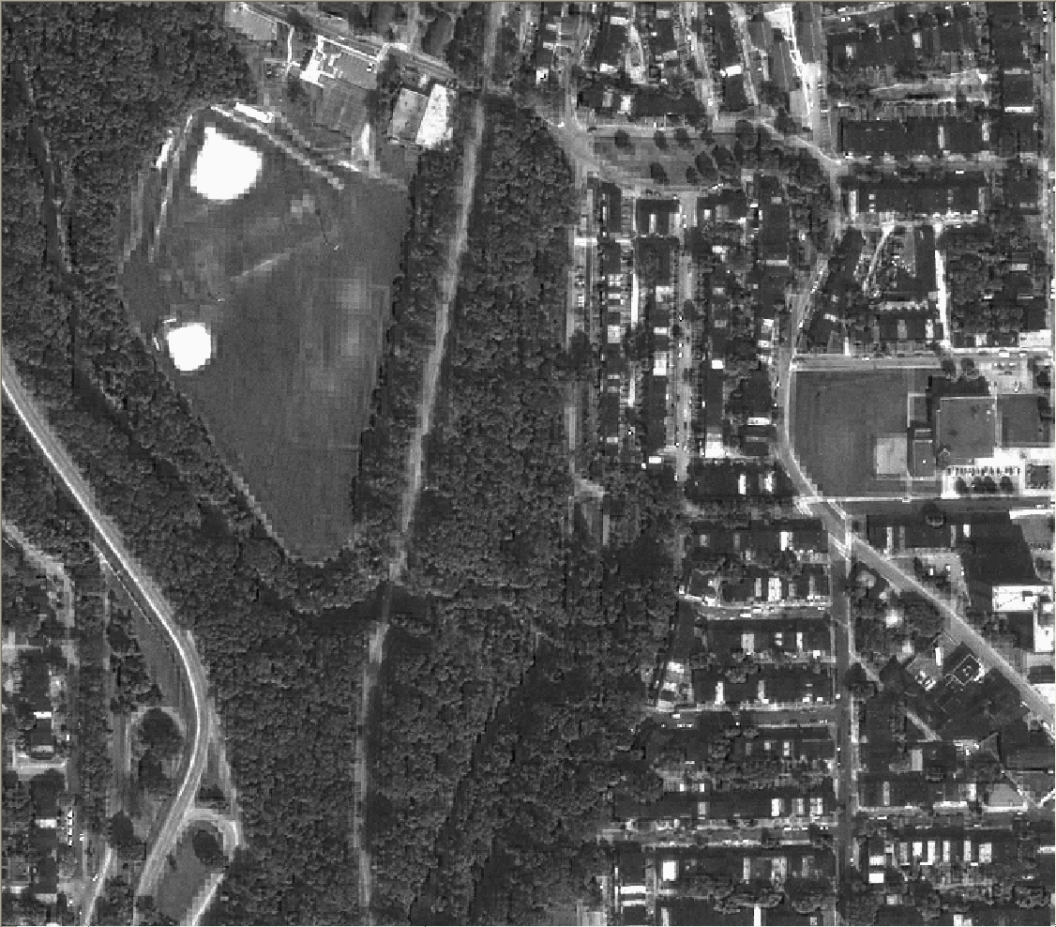
Display of Multispectral Image
NATURAL color composite
Bands
Applied to color
Resulting Image
Red
Green
Blue

Slide 41
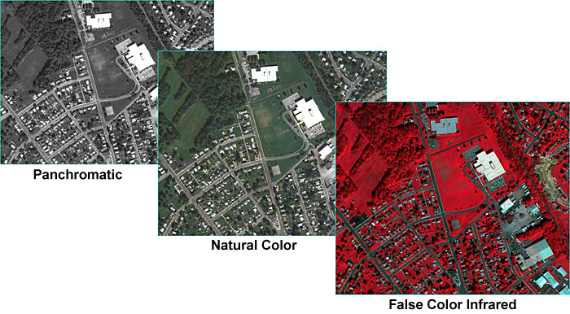
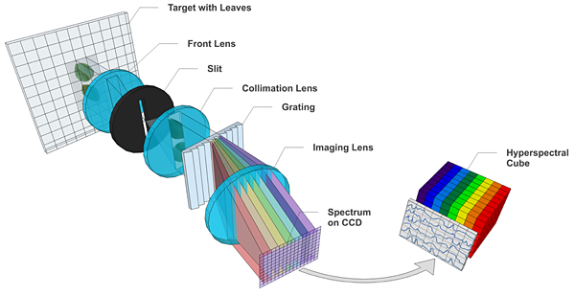

Slide 42
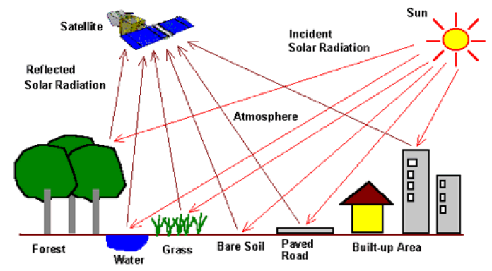
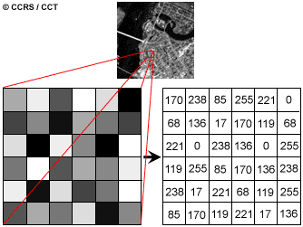
WHAT IS REMOTE SENSING DATA
A TWO DIMENSIONAL DISTRIBUTION
OF REFLECTED ENERGY

Slide 43
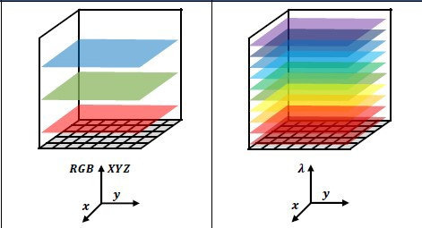

Slide 44
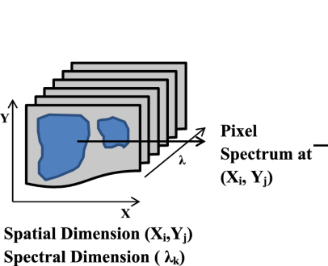

Slide 45

WHAT IS SPECTRAL SIGNATURE
Different surface types such as water, bare
ground and vegetation reflect radiation
differently in various channels. The radiation
reflected as a function of the wavelength is
called the spectral signature of the surface.

Slide 46
QUESTION BANK
EXPLAIN :
PACHROMAIC , COLOR , MULTISPECTRAL AND HYPERSPECTRAL REMOTE SENSING
What do you mean by SPECTRAL SIGNAURE

